Slide 1


ABE 715
Computer Programming
Lecture 1: Introduction & Course Overview
Department of Agricultural Engineering
Instructor: Dr. Kadeghe G. Fue
Sokoine University of Agriculture (SUA)
1

Slide 2
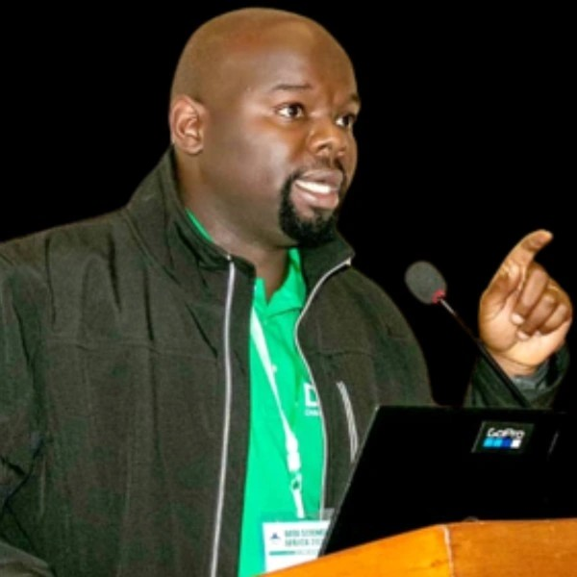
Your Instructor
Dr. Kadeghe G. Fue
Senior Lecturer, Department of Agricultural Engineering
Lead, Electronics and Precision Agriculture Lab (EPAL)
Founder, YEESI Lab (Innovation Hub)
Research: Mechatronics, Precision Agriculture, Ag Robotics, AI, Digital Environmental Health.
2

Slide 3




Target Audience & Objectives
MSc Irrigation Engineering and Management
MSc Ag & Biosystems Eng.
Focus on algorithms for water management, automating irrigation scheduling, and modeling hydraulic systems using computational methods.
Focus on machine control, biosystems automation (greenhouses), and data analysis for precision agriculture applications.
"Bridging the gap between physical engineering systems and digital logic."
3

Slide 4
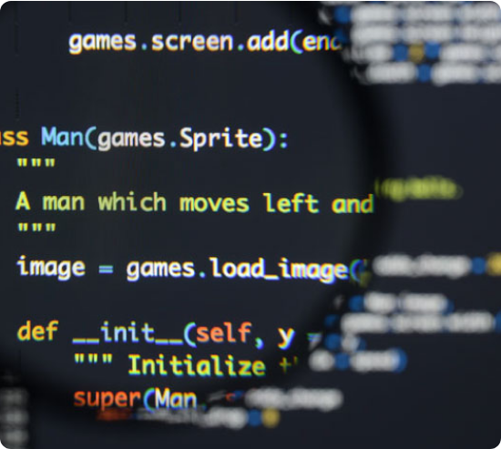
Why Programming in Engineering?
Automation: Replace manual calculations (e.g., Evapotranspiration) with automated scripts.
Data Handling: Process massive datasets from weather stations and soil sensors.
Simulation: Predict crop yields and water flow before building physical infrastructure.
IoT Integration: Connect software to hardware (sensors, drones, valves).
4

Slide 5






The Engineer's Toolkit
Python
C++
MATLAB
Primary Tool. Best for Data Science, AI, and general scripting. Huge library support (Pandas, NumPy).
Hardware Control. Essential for programming microcontrollers (Arduino, ESP32) in IoT systems.
Simulation. Legacy standard for complex mathematical modeling and control systems analysis.
5

Slide 6
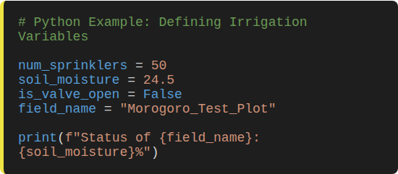
Core Concept: Variables & Data
Digital Representations
In engineering, we map physical reality to digital variables.
•
Integer: Count of sprinkler heads (e.g., 50).
•
Float: Soil moisture reading (e.g., 24.5%).
•
Boolean: Valve status (True = Open, False = Closed).
•
String: Site ID (e.g., "Field_A_North").
6

Slide 7
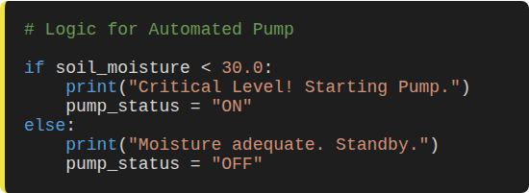
Core Concept: Logic & Control
Decision Making
Algorithms allow systems to make autonomous decisions based on data thresholds.
The "If-Else" Structure:
If condition A is met, do Action X.
Otherwise, do Action Y.
This is the brain of any smart agricultural system.
7

Slide 8
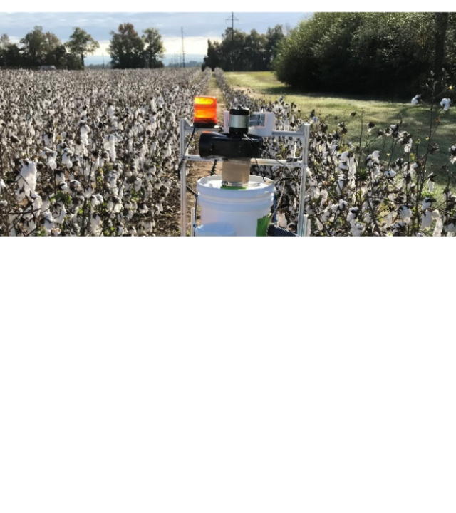

Application 1: Ag Robotics
Machine Vision for Harvesting
Dr. Fue's Research Area:
Using algorithms to identify crops in real-time.
We will explore how code processes camera data to distinguish a cotton boll from a leaf, calculating coordinates for a robotic arm to actuate.
Concept: Image Array Processing
8

Slide 9
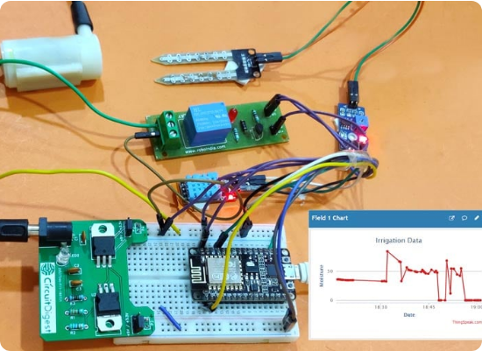
Application 2: Smart Irrigation
Salt-Affected Soils & IoT
In irrigation engineering, water quality is critical. High salinity reduces yield.
The Programming Challenge:
Develop a system that reads Electrical Conductivity (EC) sensors. If salinity spikes, the code must trigger a "flushing" event or alert the farmer via SMS.
This involves time-series data analysis and threshold logic.
9

Slide 10




Tools of the Trade
VS Code / Jupyter
GitHub (kadefue.github.io)
IoT Microcontrollers
Arduino & ESP32. We will write C++ code to interface with physical sensors in the lab.
The standard Integrated Development Environments (IDEs) for writing and testing Python code.
Version control. Essential for collaborating on engineering projects and managing code history.
10

Slide 11
Evaluation & Grading
Component | Weight | Description
Lab Assignments | 30% | Weekly coding tasks (Python/C++) solving specific engineering problems.
Mid-Semester Exam | 20% | Practical coding test covering core algorithms and logic.
Term Project | 30% | Group project: Design a complete system (e.g., Automated Greenhouse Controller).
Final Presentation | 20% | Demonstration of the term project and technical report.
11

Slide 12




Resources
Textbooks
Labs
•
"Python for Data Analysis" by Wes McKinney
Electronics and Precision Agriculture Lab (EPAL)
•
"Practical Electronics for Inventors" (for IoT/Sensors)
Located in the Dept. of Agricultural Engineering. Open access for students during assigned hours for project work.
•
Lecture Notes & Code Snippets (Provided on Moodle)
12

Slide 13


Lecture 1: Take-Home Challenge
Smart Irrigation Logic Design
Scenario: You are designing a controller for a maize field in Morogoro. The system must optimize water usage.
Task: Write pseudocode (plain English logic) for a program that:
1.
Reads a soil moisture sensor every 1 hour.
2.
Checks if the moisture level is below 30%.
3.
If low, checks if it is currently daytime (to avoid evaporation, maybe irrigate only at night? You decide the logic).
4.
Opens a solenoid valve for 15 minutes if conditions are met.
5.
Bonus: Include an error check if the sensor reads -1 (faulty).
13
Submission: Bring your logic flow to the next class.

Slide 14


Questions?
Dr. Kadeghe G. Fue
kadefue@sua.ac.tz
14

